Slide 1
Application-Level Regression Testing Framework using Jenkins
Timothy A. Bouvet, NCSA, University of Illinois
Reuben D. Budiardja, ORNL, Oak Ridge, Tennessee
Galen W. Arnold, NCSA, University of Illinois
Gregory H. Bauer, NCSA, University of Illinois

Slide 2
Talk Outline
Introduction and Motivation
Implementation & Deployment
Basic Configuration
Connecting to multiple HPC systems
Security consideration, authentication, authorization
Application Test Structure
Actual Use Cases

Slide 3
Introduction & Motivation
The complexities of monitoring an HPC system:
Layers and versions of software stack
System-level configurations
I/O components (memory, filesystem)
Diversity in user need and usage
Variable network traffic
Performance regression may occur over time
requires historical data to easily detect
Application-level regression testing
Aggregate impact?
Notes:
As we all know, monitoring large and complex HPC system is challenging. This is because there are many components to such system such as …
Either degradation of the individual component or the interaction between them may cause the performance regression of the system to occur over time. To detect such regression easily, one needs to have historical performance data.
Further more, although many system exist to monitor the individual component, the impact on aggregate level due to the interactions of these component is sometime harder to discern.
These requirements can basically be summarized by what we called “application level regression testing”. Application level means that rather than monitor these components individually, we want to see it from our users’s perspective of how our system behaves.

Slide 4
Goals
Monitor usability and performance
User-level experience
no privilege access, minimum ‘specialized’ tests
Early detection of regressions
Tests are run during production period
Automated and consistent test solution
Store historical data
Solution: Jenkins Automation Server

Slide 5

What is Jenkins?
An “open source automation server”
Automate user-level tasks
Execute arbitrary commands
Build software & submit jobs
Archive test results
Notify (email, text, …) on error
“Never sleeps or takes vacation”
Chosen for
versatility
multitudes of plugins (plot, ssh, … )
large community support

Slide 6
Implementation & Deployment

Slide 7
Basic Configuration
Jenkins (master) on CentOS VM (GUI, archive, …)
slave.jar daemon
SSH Plugin
HPC 1
HPC 2
HPC 3
Jenkins “node”
application tests / scripts
run on HPC systems
Notes:
Jenkins is typically available from package repository of most linux distribution. In our case we use CentOS running on a VM and installed Jenkins from RPM. It comes with its own webserver and provide UI via web-browser where one can setup and input scripts and test. In a little bit we’ll discuss how we set it up for better security.
Jenkins master can talk to the HPC system via 2 methods: first by running a daemon on the login node of the system and set it up as Jenkins’ Node, second by using Jenkins SSH plugin

Slide 8
Accessing (Remote) HPC Test Systems
Jenkins “Node”
Requires running “slave.jar” daemon
Daemon connects back to master on specific port
Remote execution appears “local”
no need to copy files / data
can access lustre, /home as if they are local resources
With SSH Plugin
Need to set up passwordless login with SSH keys
Closer resemblance to user experience
Have to manually manage data movement (file copying, getting results back) to
NICS
NCSA

Slide 9
Security Considerations
Jenkins allows execution of arbitrary command
use Apache HTTPD server in front of Jenkins’, pass requests via mod_proxy
allow authenticated access only from institutional IPs via firewall rules
use RSA OTP for authentication via pwauth + custom session management (details in paper)
Use LDAP for authorization with Jenkins “matrix-based” security
Notes:
Enabling Jenkins access to Blue Waters posed some unique security hurdles that we had to overcome. Jenkins has some unfortunate default settings. The access control is set to ”Jenkins’ own user database,” and the ”Allow users to sign up” option is enabled, so if you don’t have an account, you can create one by providing your name, e-mail and a password. Additionally, there’s an authorization option enabled which says ”Logged-in users can do anything.” So, once signed in, you have full admin access to the Jenkins system instance. This required us initially to test the deployment with our test and development (TDS) CRAY.

Slide 10
OTP
LDAP
/etc/httpd/conf.d/ssl.conf
Port 443
HTTP Header
PWAUTH
Username
SSL, OTP
443
SSL
Decrypt
Encrypt
Centos VM
SSH
JENKINS WS LOCALHOST
Port 8080
IPTABLES
OTP
Port 80
80
Anonymous
Apache
GET Requests
/etc/httpd/conf.d/vhosts.conf
BWJENKINS MASTER NODE
Notes:
This is our NCSA Mater Jenkins Node which is a Centos Virtual Machine. The Jenkins Web Server (Port 8080) is restricted to Local Host only. IPTables restricts access to our server. Apache is used as Front End to Jenkins and handles all security and authorization. It forwards all HTTP requests to Jenkins and returns responses to the client by reverse proxy via mod_proxy apache module. It decrypts and encrypts SSL traffic (port 443) which is configured in ssl.conf. Authorization is by pwauth authenticator which interfaces with our OTP server via mod_authnz_external apache module and Pam. Apache sends username to Jenkins via HTTP header. We use the built-in LDAP plugin to query our LDAP server for a user’s group information. Unencrypted anonymous read only traffic is allowed through port 80 configured in vhosts.conf. Configuration details are documented in the paper.

Slide 11
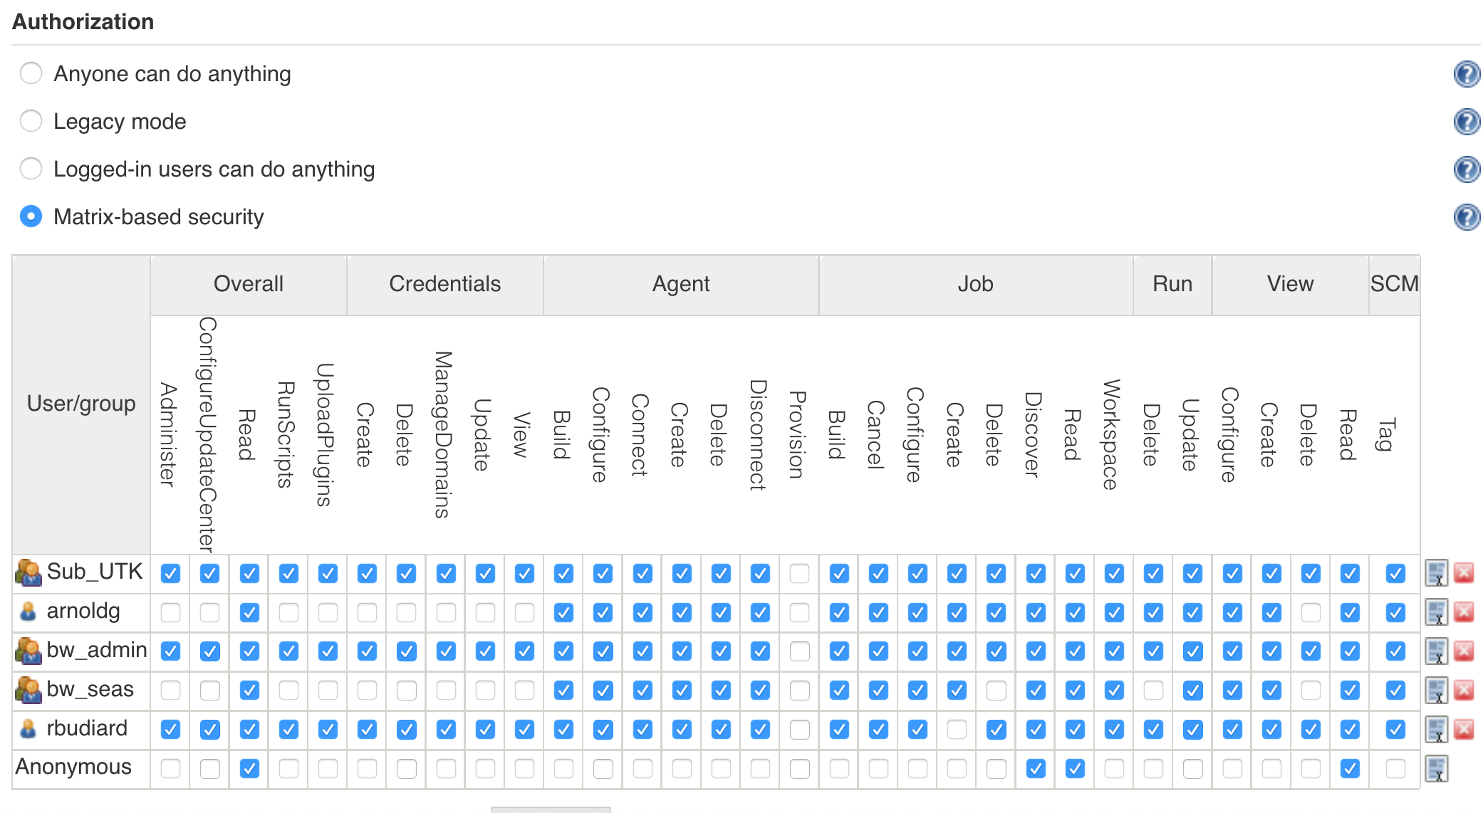
Jenkins Global Security
Notes:
We wanted fine grained access control to our instance and therefore selected the ”matrix-based security“ option. For example we restrict most users from having the ”Job Delete“ permission to prevent one user or group from deleting each other’s jobs.

Slide 12
Application Test Structure

Slide 13
An Application Test: Jenkins Project
Name and description - what is tested, frequency, resources
Limit number of “builds” kept - conserve server storage
Source code management - subversion or git
Build trigger - manual or automated schedule
Build commands – shell commands to execute test
Post-build Actions – generate plots, notifications on failure
Project can be easily copied from an existing one

Slide 14
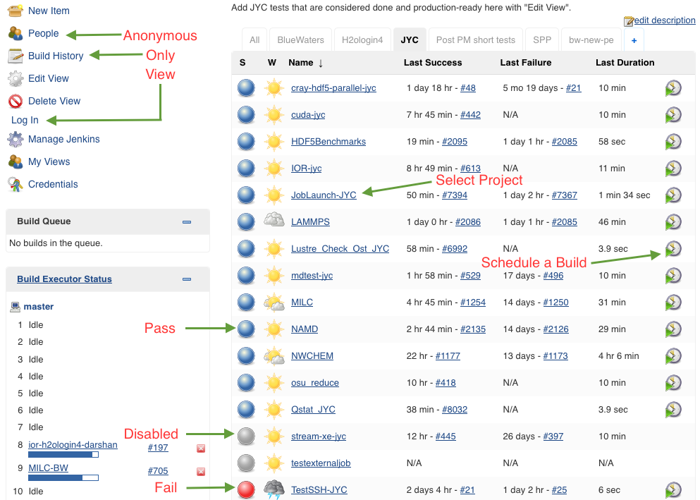
Admin Gui Home Page
Notes:
This is the Administrative Home Page. Status of all jobs in view (pass, fail, disabled) are displayed. From this page you can schedule an immediate build of a Project or drill down to a specific Project. Note our Anonymous View has a limited read only view of build history.

Slide 15
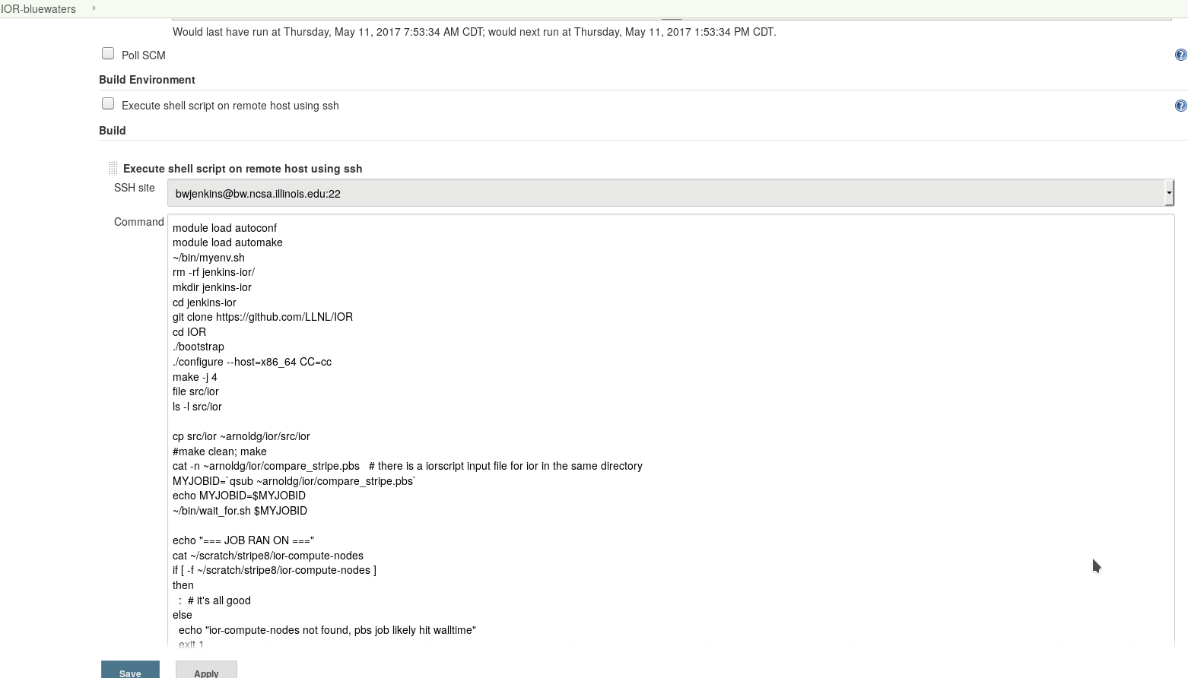
Test Script

Slide 16
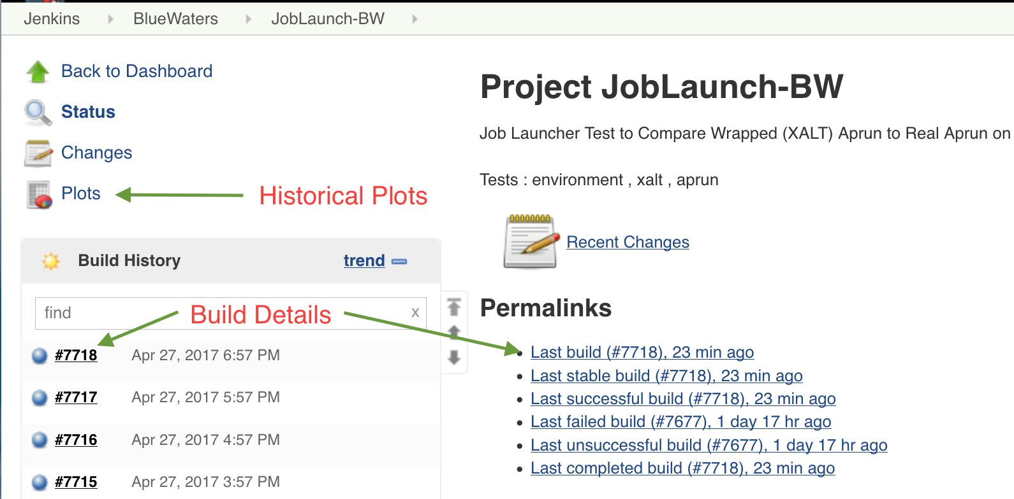
Project View
Notes:
From a project view you can select historical plots over time. You can also pick a specific build for more information like console logs shown on next graphic.

Slide 17
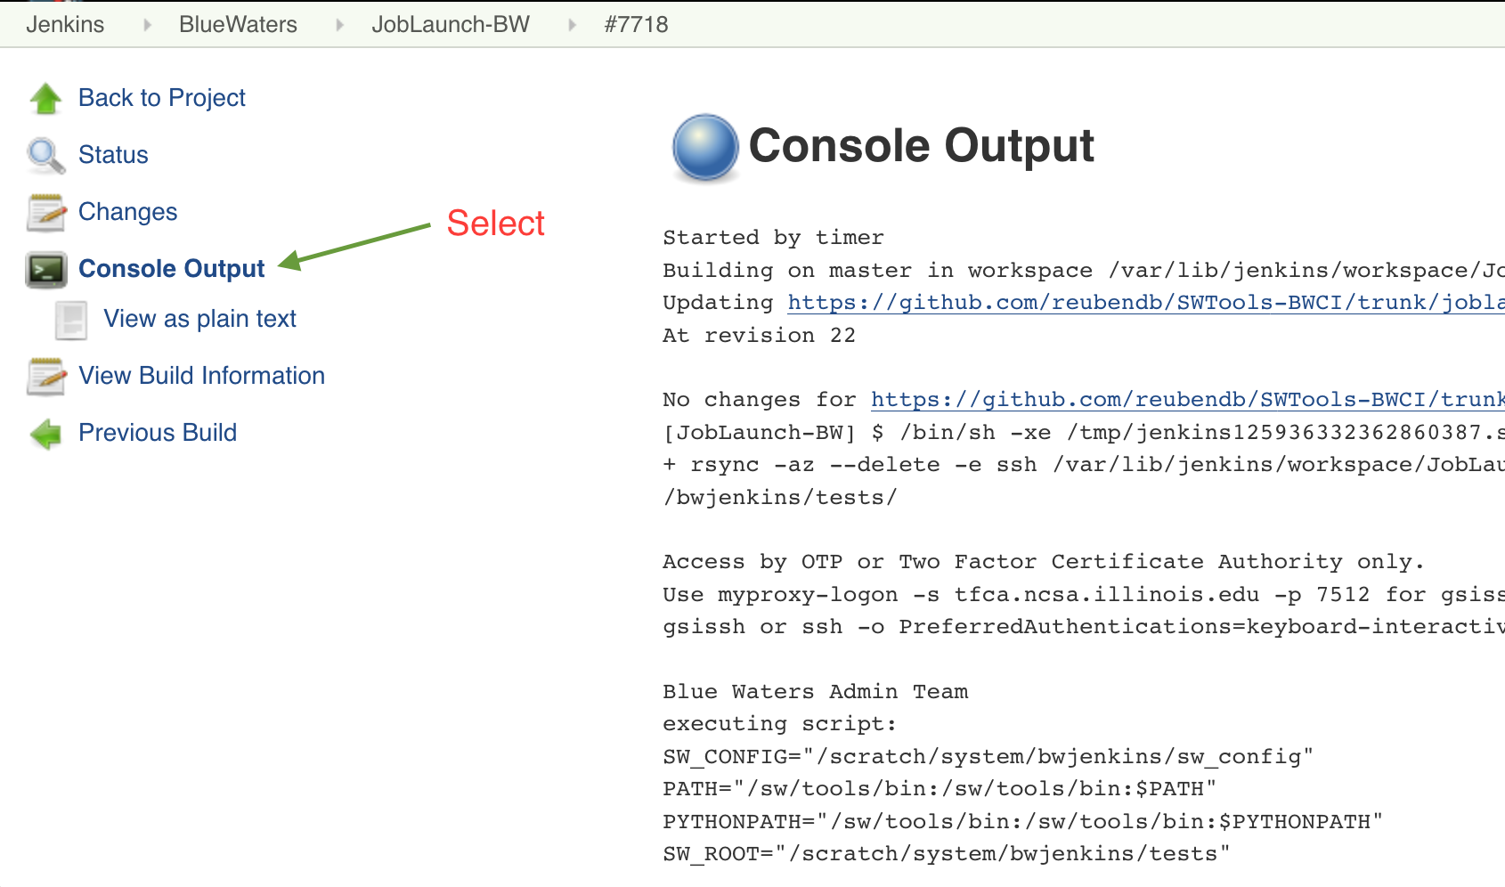
Example Console Log
Notes:
Example of a Project console log is shown here.

Slide 18
Use Cases

Slide 19
Project Failure Email Notification
See <http://bwjenkins.ncsa.illinois.edu/job/Lustre_Check_OST_BW/7218/display/redirect>
------------------------------------------
Started by timer
Building on master in workspace <http://bwjenkins.ncsa.illinois.edu/job/Lustre_Check_OST_BW/ws/>
executing script:
SW_WORKDIR="/scratch/system/bwjenkins/sw_workdir"
JOB_NAME="Lustre_Check_OST_BW"
snx11003-OST010c-osc-ffff885fc0cd3c00: check error: Resource temporarily unavailable
[SSH] exit-status: 255
Build step 'Execute shell script on remote host using ssh' marked build as failure
Recording plot data
Saving plot series data from: <http://bwjenkins.ncsa.illinois.edu/job/Lustre_Check_OST_BW/ws/bw_active>
Notes:
This is an example of email message from failed Jenkins test. We had a Lustre OST go offline that later recovered. This test failure also sends a text message to the On-Call administrator’s phone

Slide 20
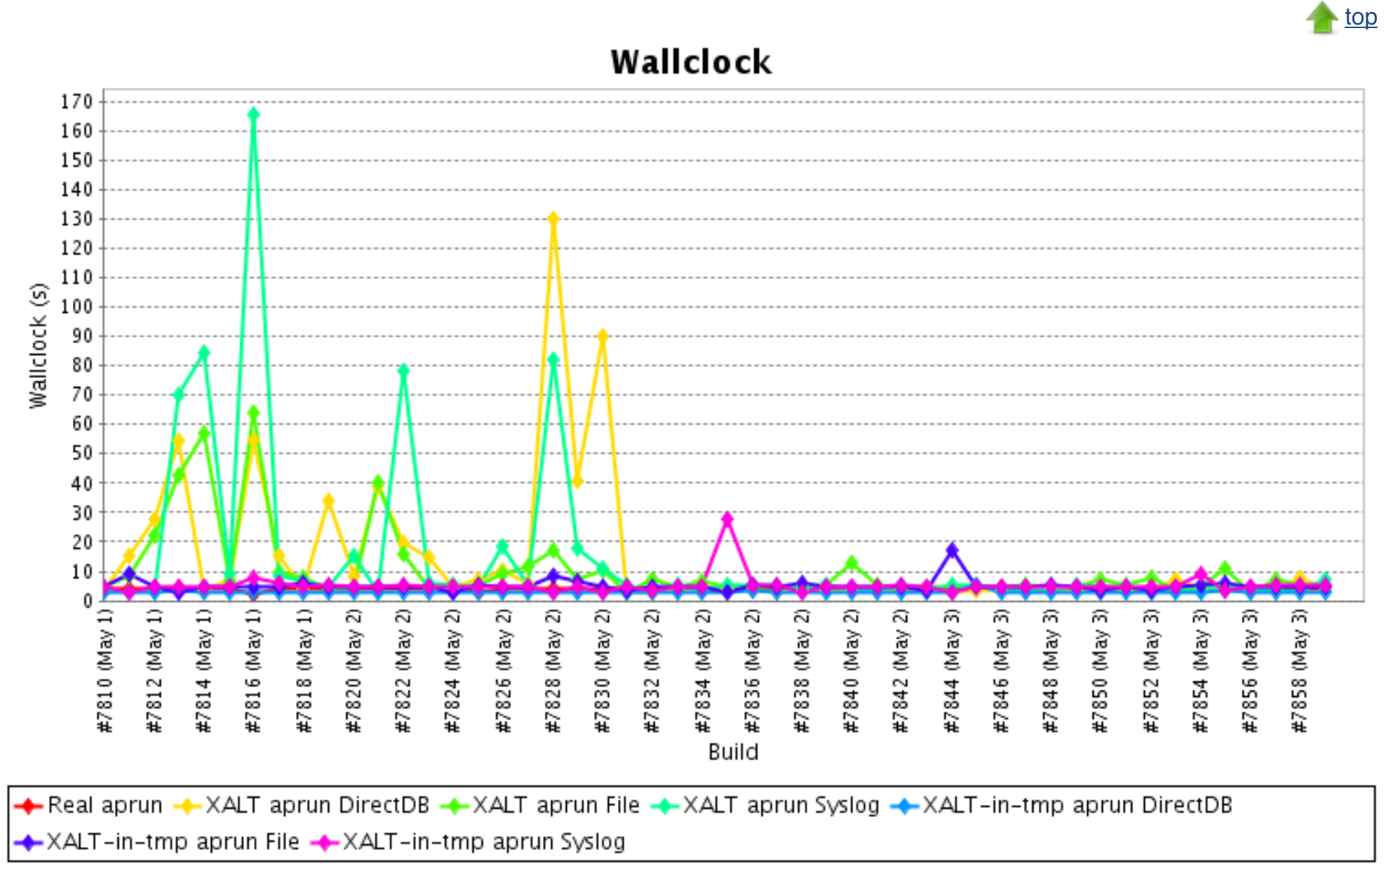
Slow JobLaunch-BW Plot
Notes:
This plot helped identify xalt default version of software causing delays in Job Launch on BW. It was determined that the software was located on a slow Lustre OST. The software was relocated to different OST’s May 2nd and as you can see the Job Launch slowness has since dissipated.

Slide 21
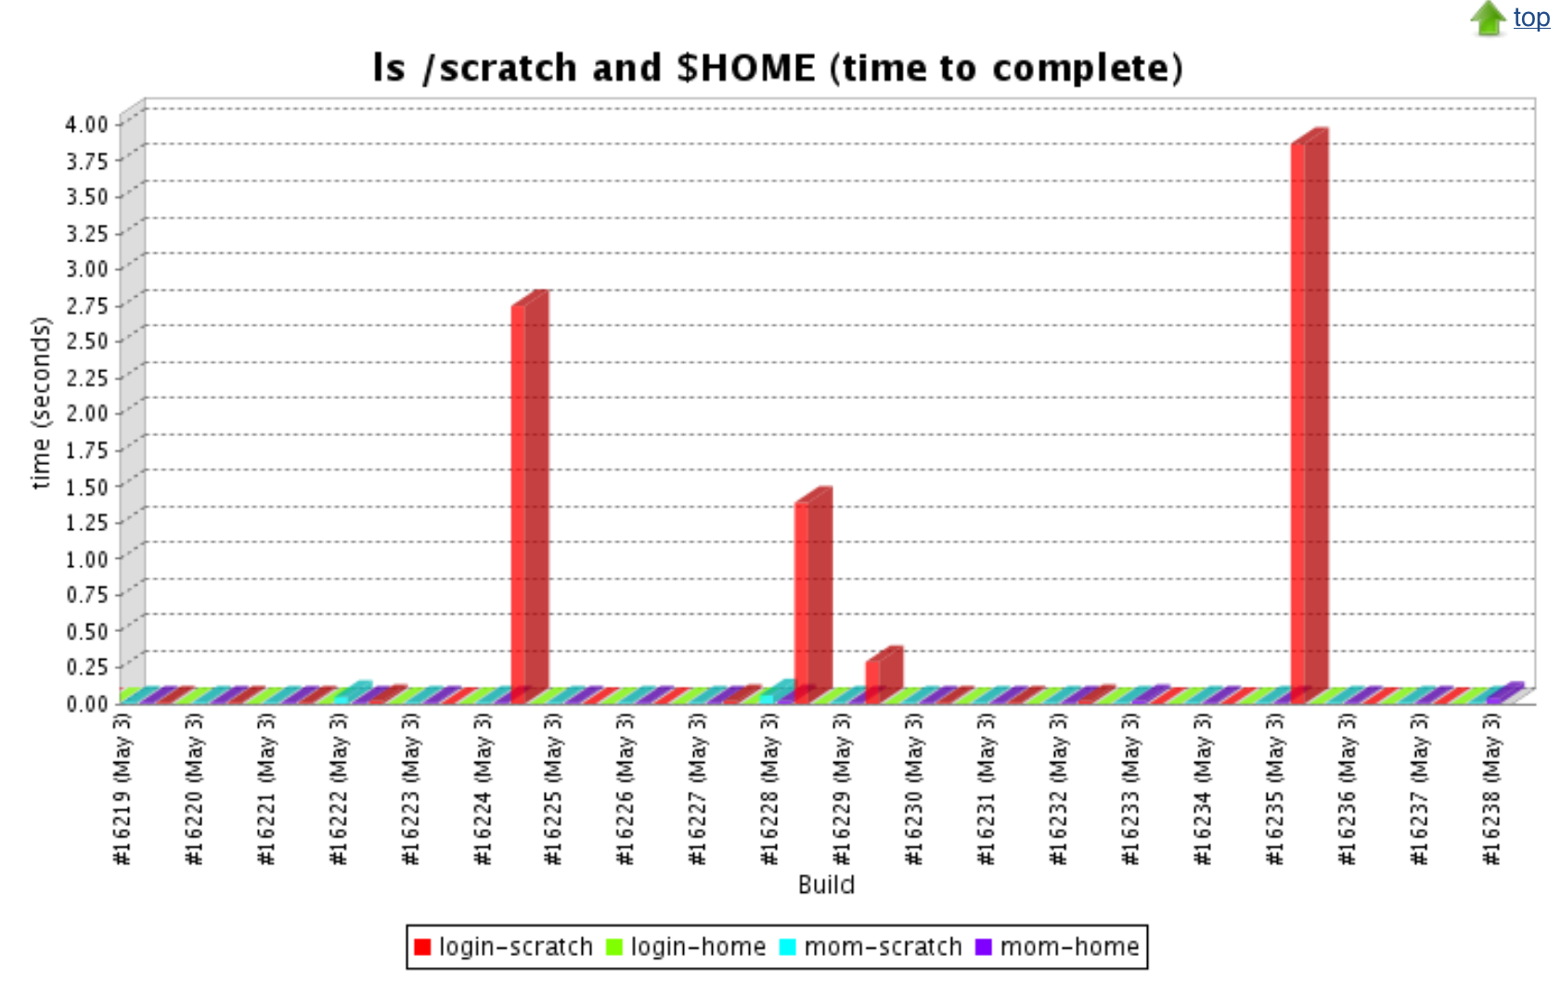
Slow Lustre Scratch from a login node
Notes:
This plot indicates a slow Lustre Scratch file system as seen from a specific login node. Lustre scratch is responding well on the internal mom nodes. It was determined that the user work load on the login node was the cause for slow filesystem indicated.

Slide 22
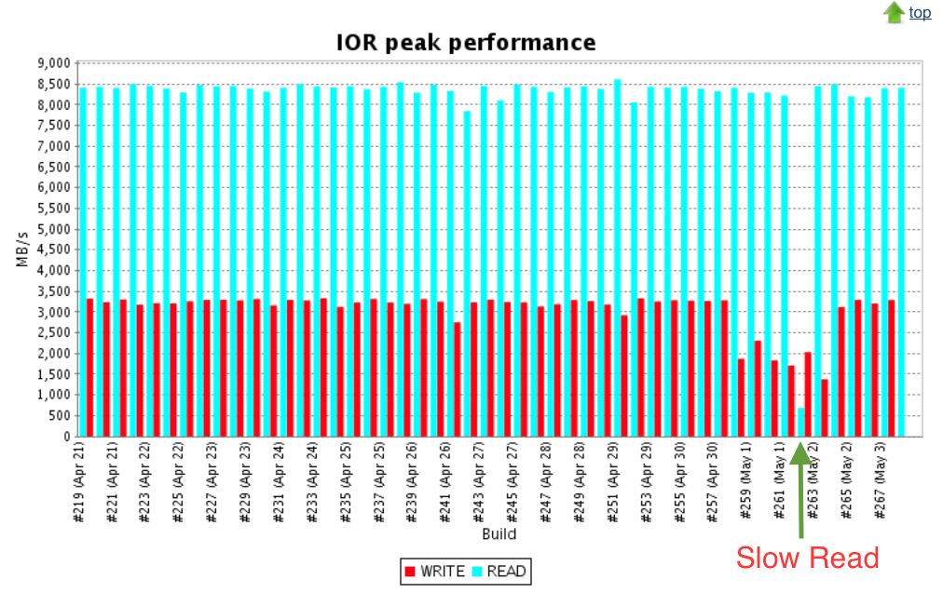
Slow IOR-login Test Example
Notes:
The slow read rate for test #262 was caused by (Unavailable Home File System). A login node lost connection to the Lustre HOME MDT during compilation of the project that later recovered. The job did complete and produced a poor performance number related to the file system issue.

Slide 23
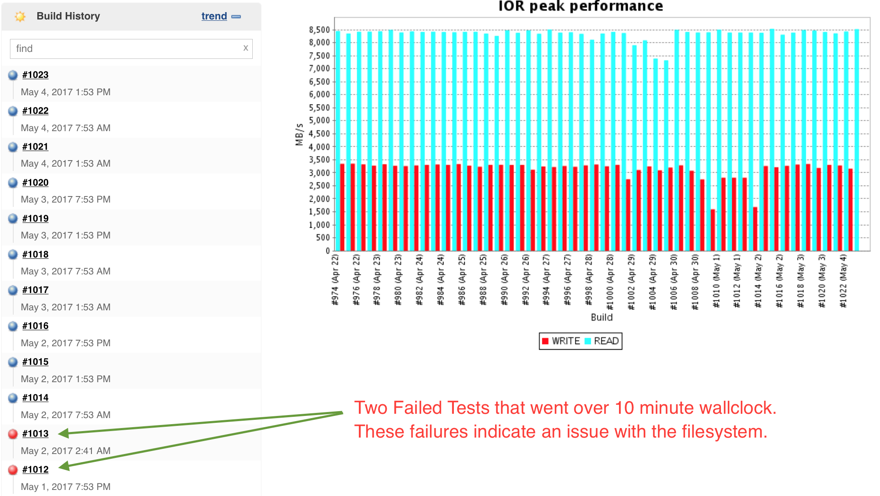
IOR-BlueWaters test failures
Notes:
Here we have two Project failures. These tests were killed because they went over 10 minutes wall clock. This is normally an issue we see during a file system issue.

Slide 24
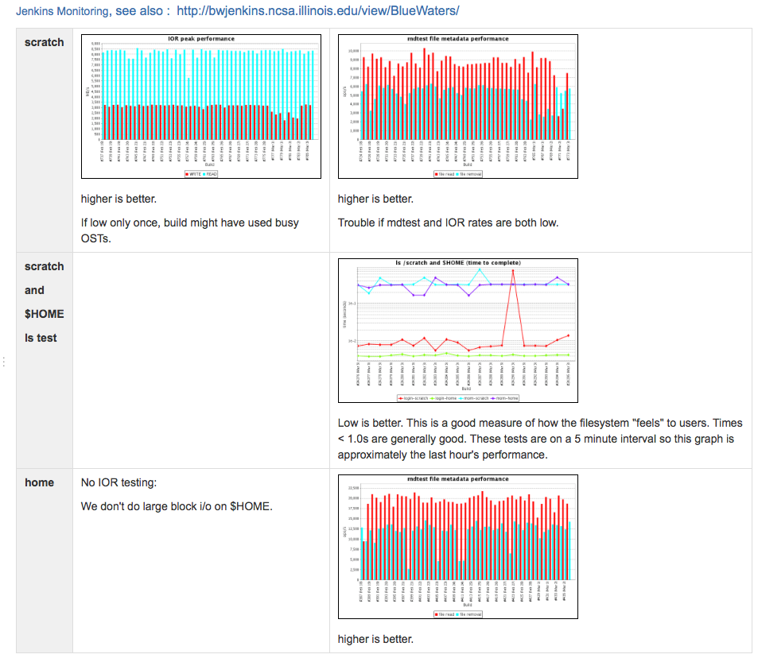
Plot Usage : Wiki Filesystem dashboard
Notes:
While supporting users, we utilize several Jenkins URL plots in our Wiki Filesystem Dashboard to quickly determine the health of our Lustre file systems.

Slide 25
Conclusion
Regression testing framework, enabling:
Reproducibility of tests
Regression testing
Rapid reaction ← more tests are added as needed
Has been deployed at
Blue Waters at NCSA
NICS
Compute and Data Environment for Science (CADES) at ORNL (in progress)
Future work: integrate with other change managers

Slide 27
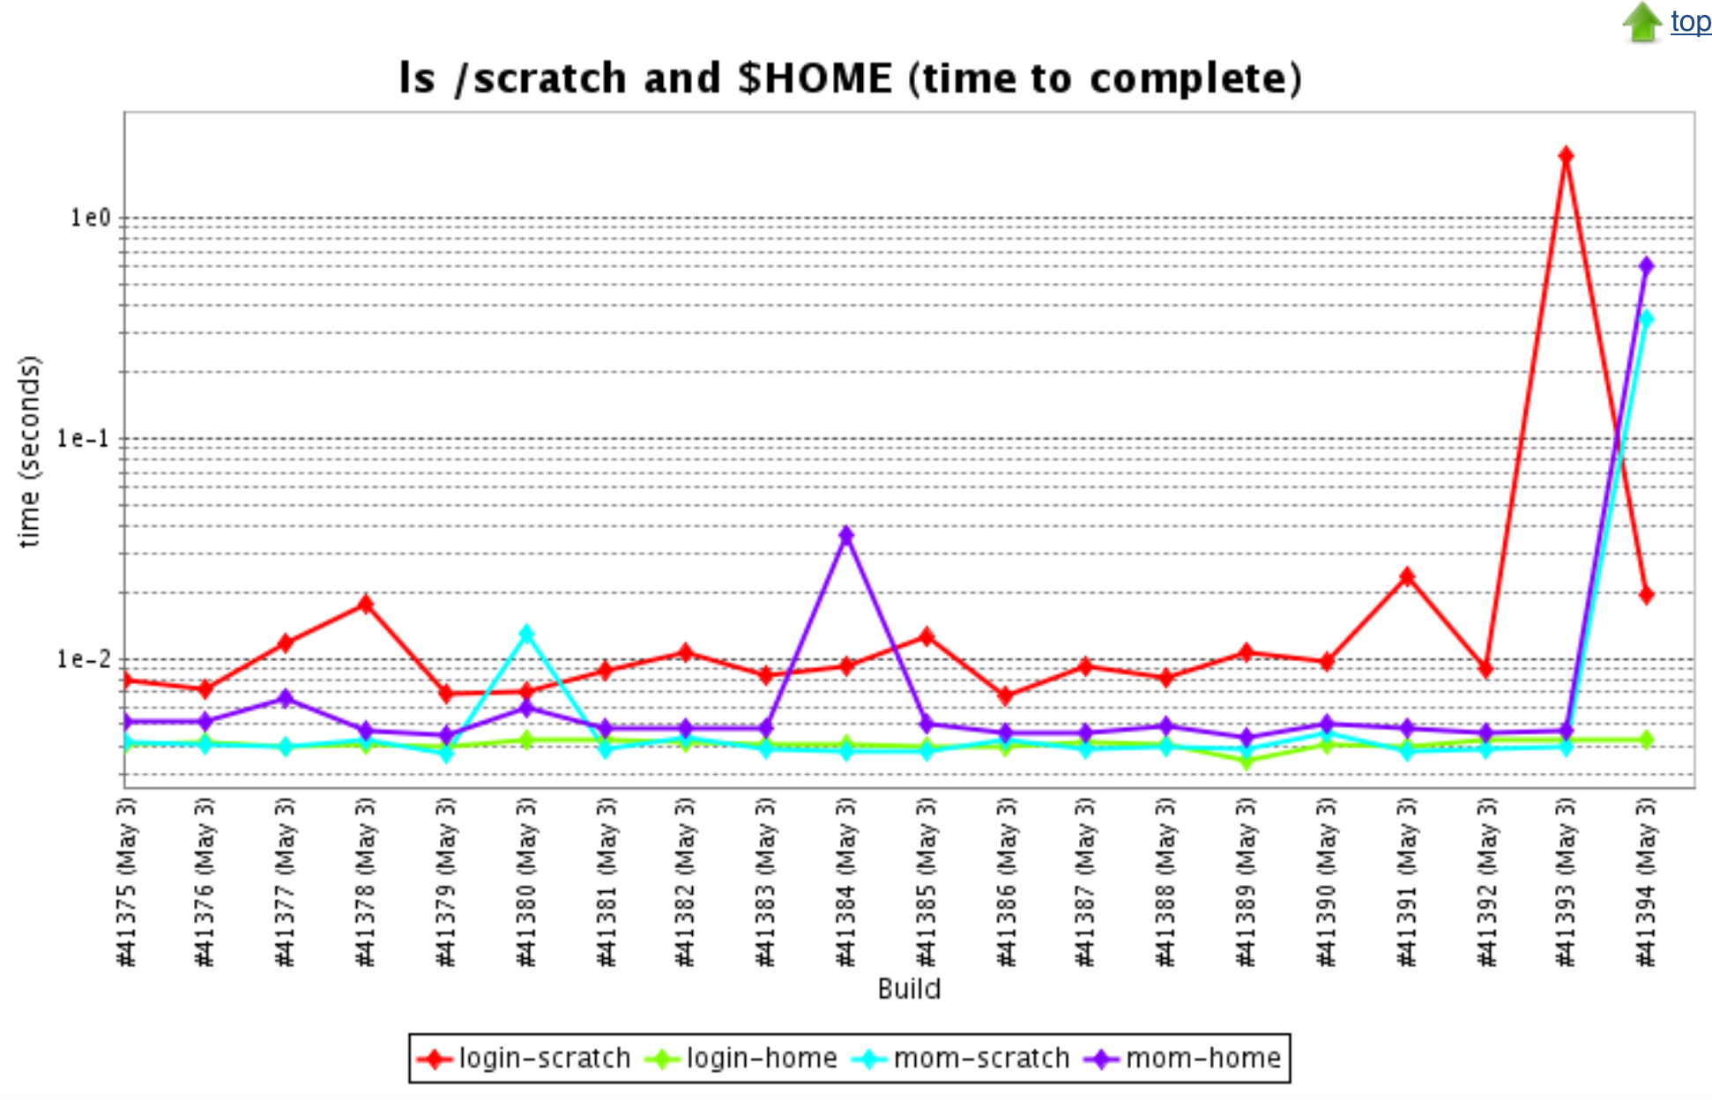
Delete?

Slide 28
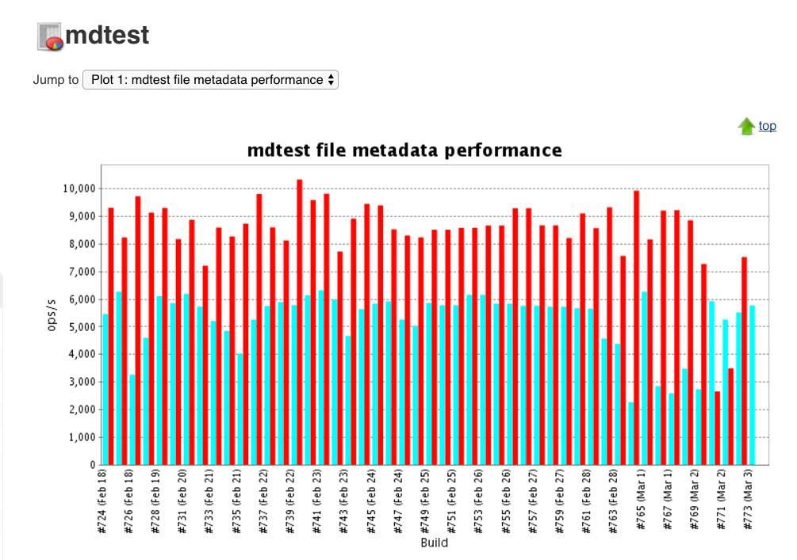
Delete Mdtest Test plot

Slide 29
Acknowledgements – delete?
Special thanks to
Galen Arnold NCSA – test integrator
Rueben Budiardja NICS – Jenkins install/configuration and test integrator
Gary Rodgers NICS – httpd configuration

Slide 30
Delete? Master Node Configuration
Centos 6.8 virtual machine
Physical access restricted to OTP secure server
Installed Jenkins
Configured jenkins behind apache
Generated unique ssh keys (var/lib/jenkins/.ssh)
Jenkins GUI – Manage Jenkins; Configure System
SSH remote hosts section
Add hostname; Port; Username (for each client resource)
sshkey Passphrase; Keyfile location (on server)

Slide 31
Delete? Usability Impacts
CRAY Programming Environment Updates
System and Third Party Software Updates
Scheduled Maintenance
Weekly warm hardware swaps
Lustre Degradation Issues
User workload interactions
Environment (power & cooling)

Slide 32
Delete: Master Node Apache & OTP
Default Jenkins web server port 8080
/etc/sysconfig/jenkins JENKINS_LISTEN_ADDRESS=127.0.0.1
/etc/httpd/conf.d/ssl.conf
ProxyPass / http://localhost:8080/ nocanon
ProxyPassReverse / http://localhost:8080/
ProxyPassReverse / http://bwjenkins.ncsa.illinois.edu/
RequestHeader set X-Forwarded-Proto "https"
RequestHeader set X-Forwarded-Port "443"
Installed mod_authnz_external native package
/usr/local/bin/pwauth+session: https://github.com/reubendb/ BasicAuthOTPSession/blob/master/BasicAuthOTPSession.py#L1

Slide 33
Delete- Jenkins Demo?
http://bwjenkins.ncsa.illinois.edu

